Slide 1
Final presentation
Wireless link project - MCC125
Wakie Talkies

Slide 2
Presentation
General information
Hardware
Transmitter
Receiver
Software
Transmitter
Receiver
Results

Slide 3

General information
Goal: Transmitting and receiving signal on 100 m distance
Frequency 2.4 GHz, bitrate 50 k bits/s and signal bandwidth 20 kHz and 40kHz
QPSK and 16-QAM modulation
Pathloss calculated depending on Friis equation

Slide 4
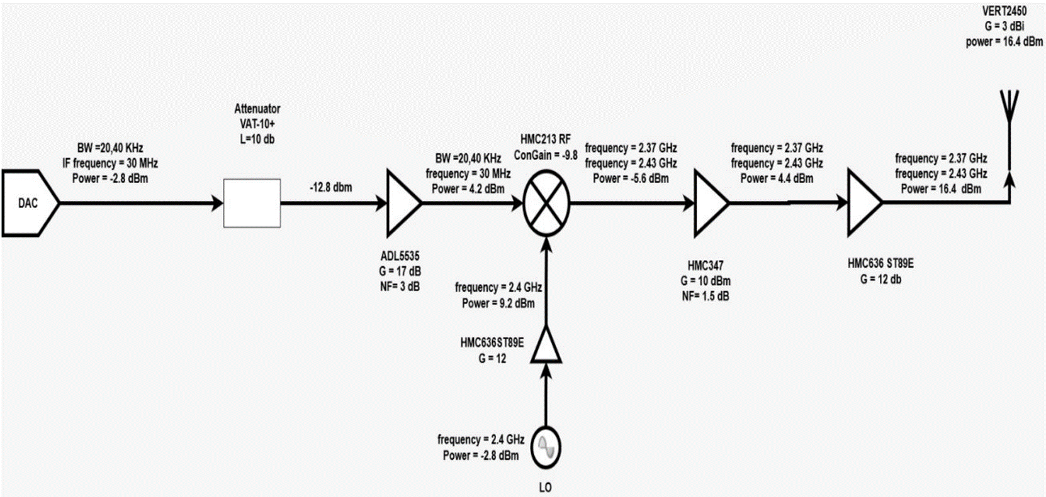
Transmitter block diagram

Slide 5
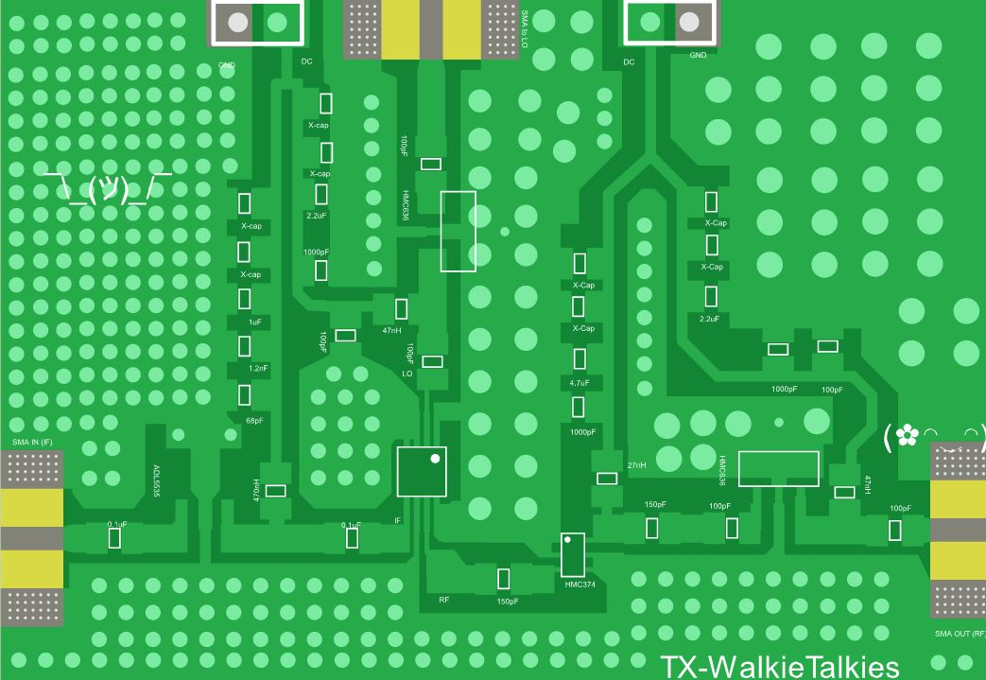
Transmitter circuit
Part | Function
ADL5535 | GP Amp
HMC213 | Mixer
HMC636 | GP Amp
HMC374 | LNA
TX: Gain 19.2 dB
Actual TX: Gain 15 dB
TX: Power 16dBm
Actual TX: Power 14dBm
ADL5535
HMC213
HMC636
HMC374
HMC636

Slide 6
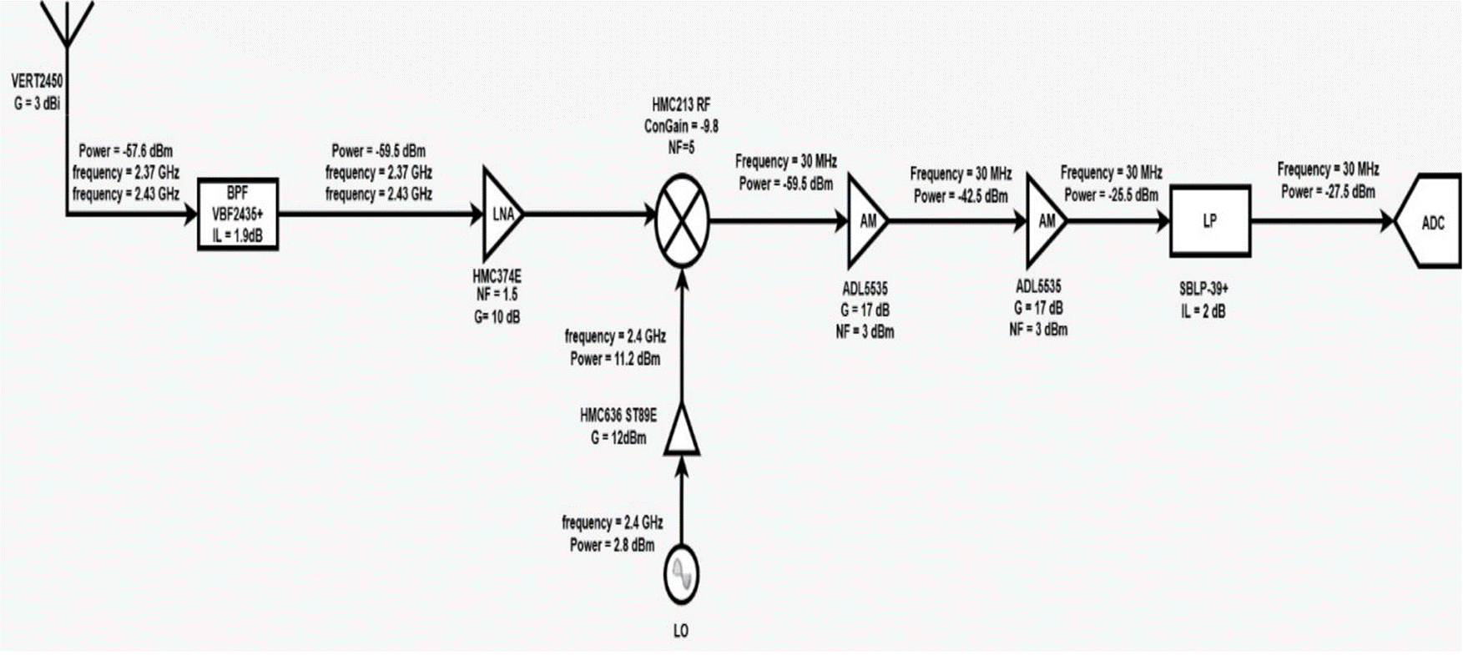
Receiver Block diagram

Slide 7
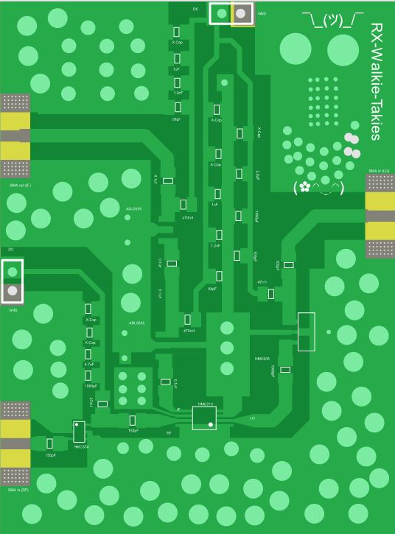
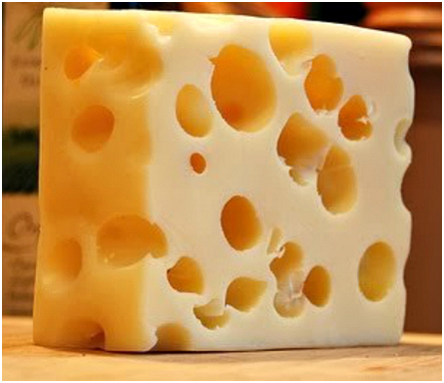
Receiver circuit
Part | Function
ADL5535 | GP Amp
HMC213 | Mixer
HMC636 | GP Amp
HMC374 | LNA
RX: Gain 30 dB (Designed)
Actual RX Gain 20-25 dB (varies wrt. LO power)
HMC374
ADL5535
HMC213
HMC636

Slide 8
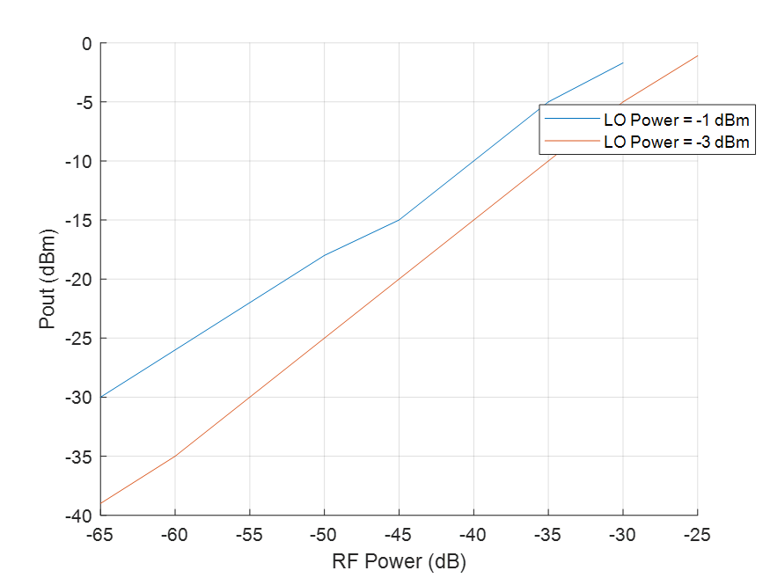
Saturation Plots
Demonstrated Values: TX:
LO Power -3dBm
Output Power 14 dBm
RX:
LO Power -2 dBm
Not enough measurements were taken to see the saturation

Slide 9
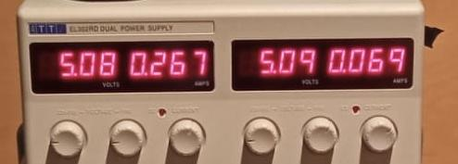
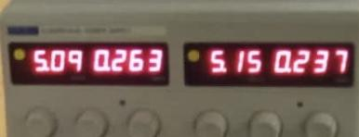
Power Consumption
RX: 5.08V, 0.336A
Power consumption = 1.7W
TX: 5.1V, 0.5A
Power consumption = 2.55W
RX
TX

Slide 10
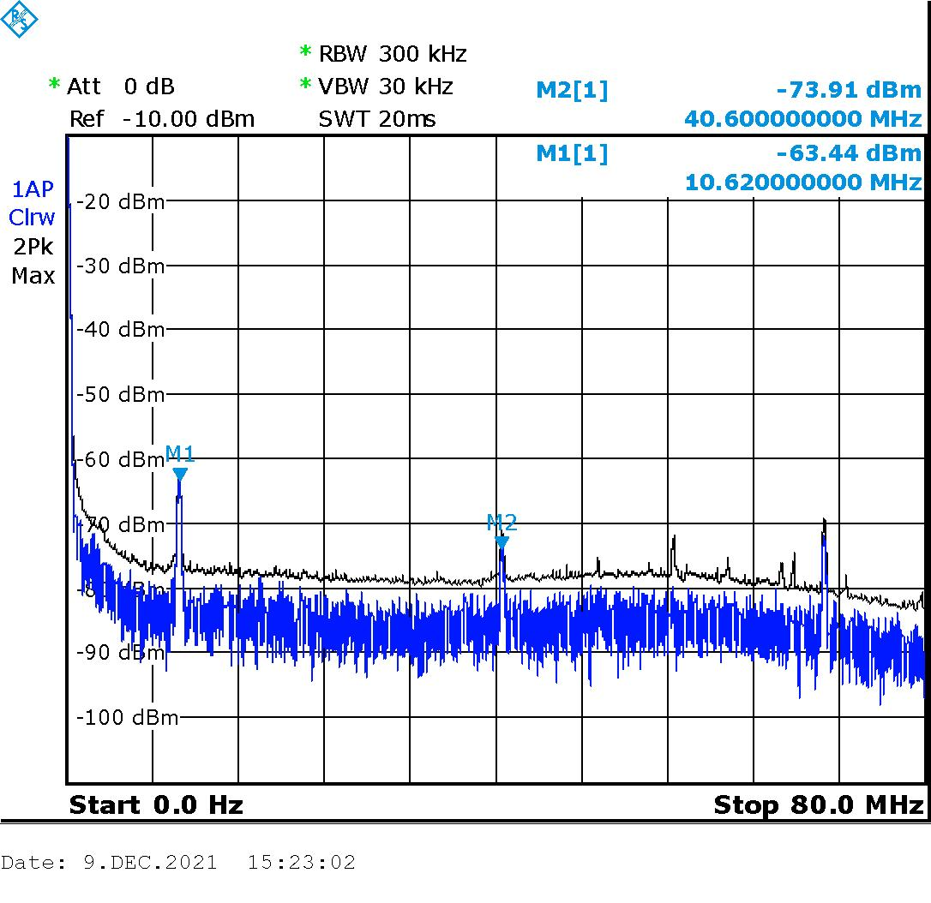
Challenges Faced
Non-linearities: Non-linearities were seen in transmitter due to the saturation of the LO power. This was overcome with an attenuator at the LO port
Oscillations: At the receiver, oscillations were observed and they are later minimised by adding capacitors and separating the bias while driving less LO power

Slide 11
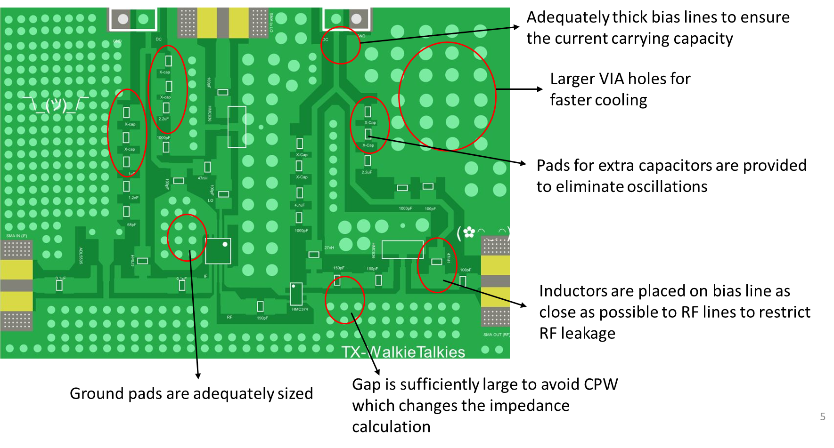
PCB Design: Things to consider

Slide 12
Software - Transmitter block diagram
Preamble
Guard and Pilot
Text to Bits
Mapper
Message
USRP
RRC
Upsample

Slide 13
Software - Transmitter details
Frame
Message: Text
Preamble: Random bits, 100 for QPSK, 200 for 16-QAM, 50 symbole
Pilot: 300 ones
Guard: 50 zeros
Mapping: QPSK and 16-QAM
Upsampling
Filter with root raised cosine
Send to USRP
Guard
Pilot
Preamble
Message

Slide 14
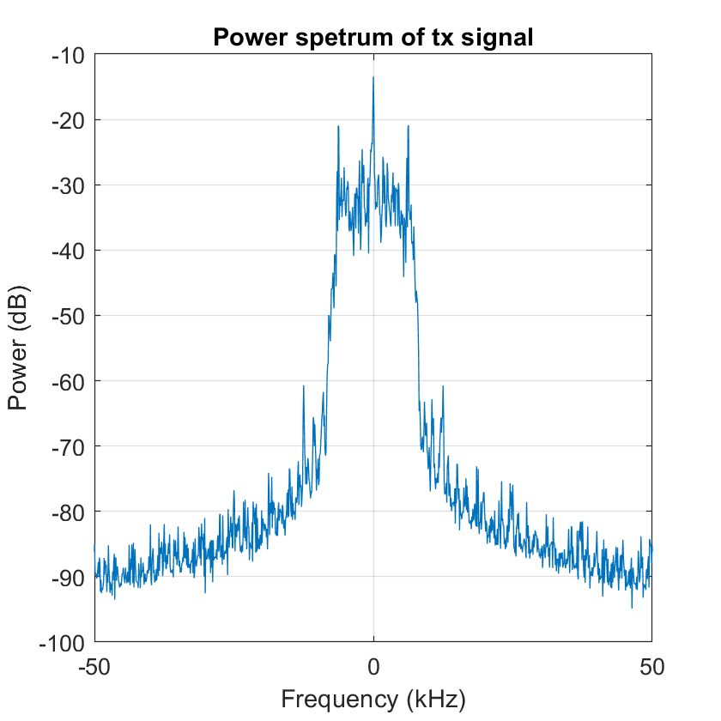
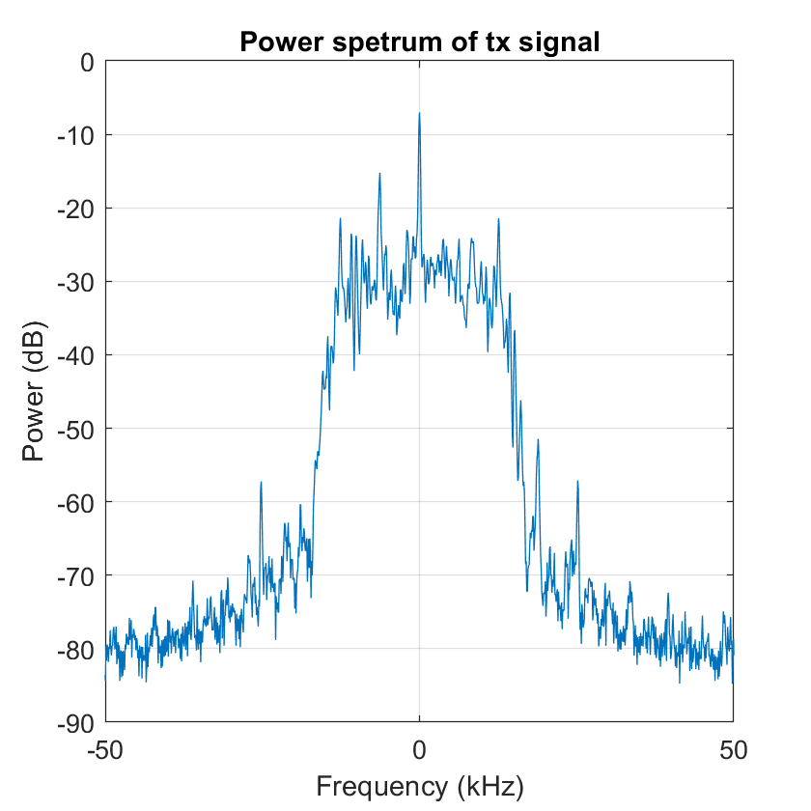
Software - Transmitted signal
16-QAM
QPSK

Slide 15
Software - Receiver block diagram
USRP
Corsa frequency correction
Matched filter
Frame detection
Phase synchronisation
Cut frame
Frequency synchronisation
Downsampling
Scale
Demapper
Bits to Text
Message

Slide 16
Software - Receiver details
Coarse frequency correction
Correct the frequency offset by finding the highest peak of the rx signal and calculate the shift.
Matched filter
Reduce the noise.
Frame detection
Correlation between rx signal and tx preamble to find the highest correlation point, which corresponds to the index where the preamble ends.

Slide 17
Software - Receiver details
Downsampling
Frequency synchronisation
Use rx preamble and tx preamble and calculate the angle difference between them. Polyfit a line (the slope) between them to get the gradient of the line, which corresponds to the frequency shift.
Cut frame
Cut out the message symbols from the downsampled frame.
Phase synchronisation
Use same method as for the frequency synchronisation, but use the first value in the polyfit line to correct the phase shift.

Slide 18
Software - Receiver details
Scale symbols
Calculate the amplitude difference between constellation and rx symbols and use it to scale signal.
Demapping: QPSK and 16-QAM
Bits to text -> Message

Slide 19
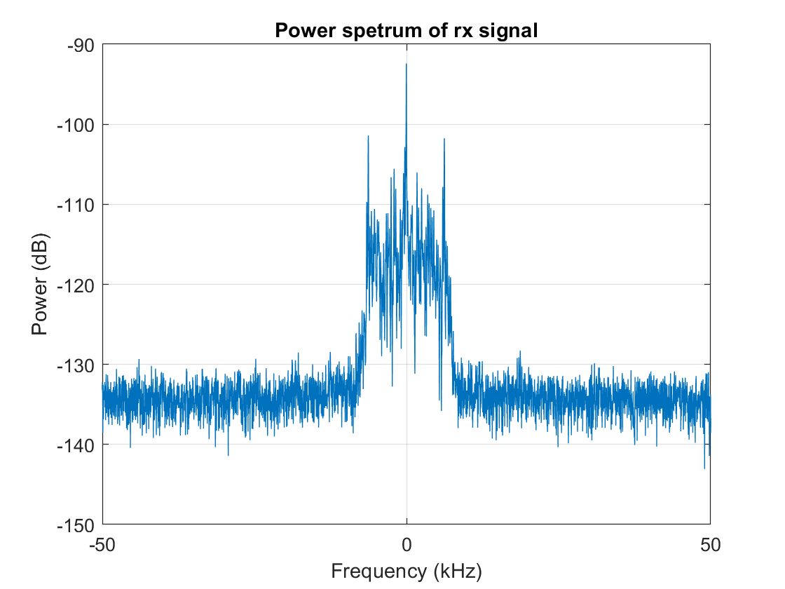
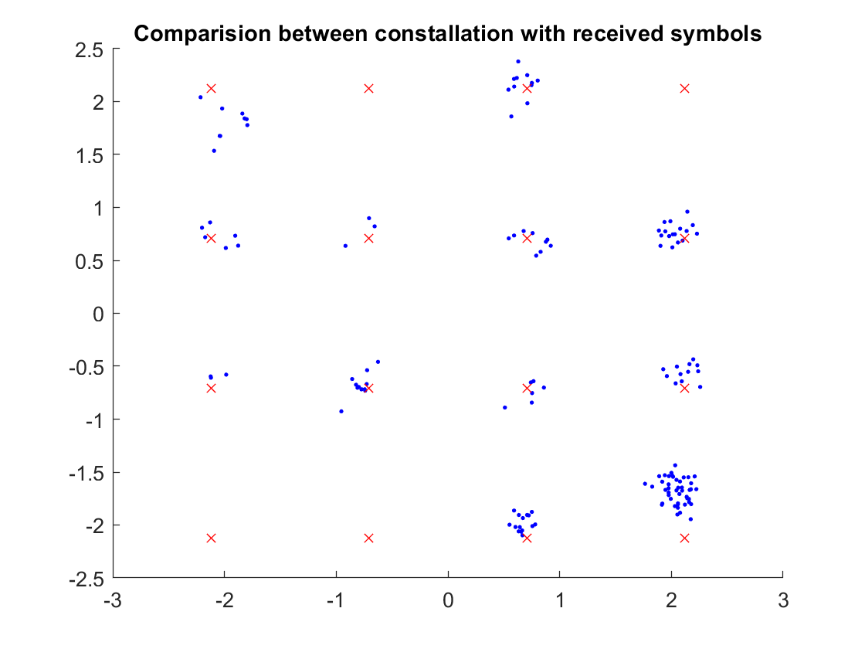
Results - Perfect 16-QAM
Constellation: 16 - QAM
Frame symbols: 548
Symbol rate: 12,5 k
Bit errors: 0
Distance : 100 m

Slide 20
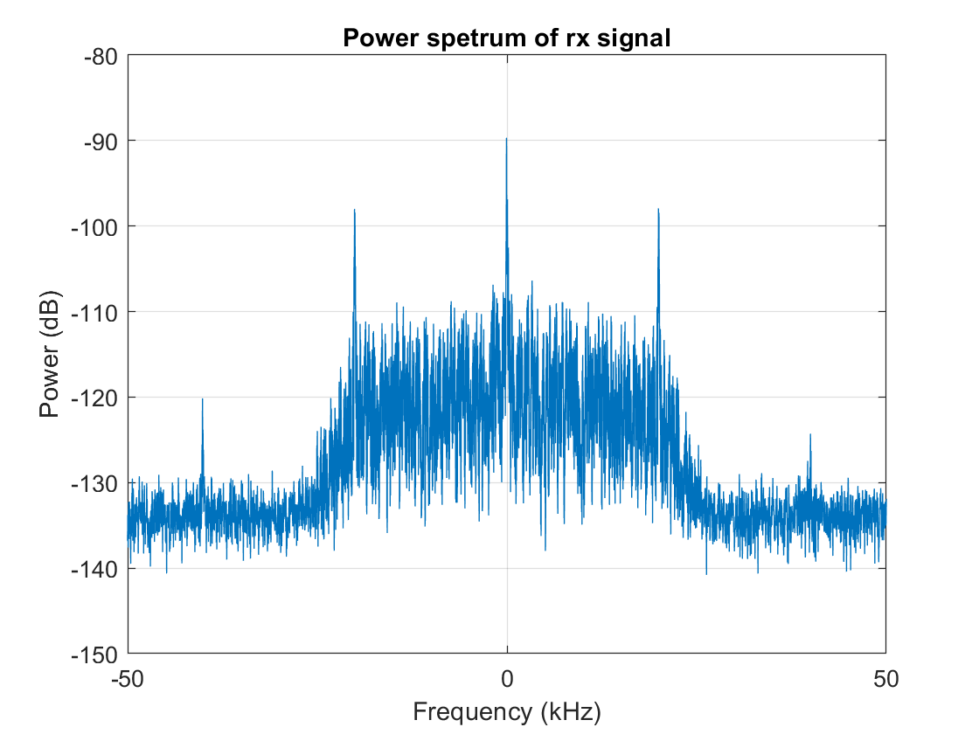
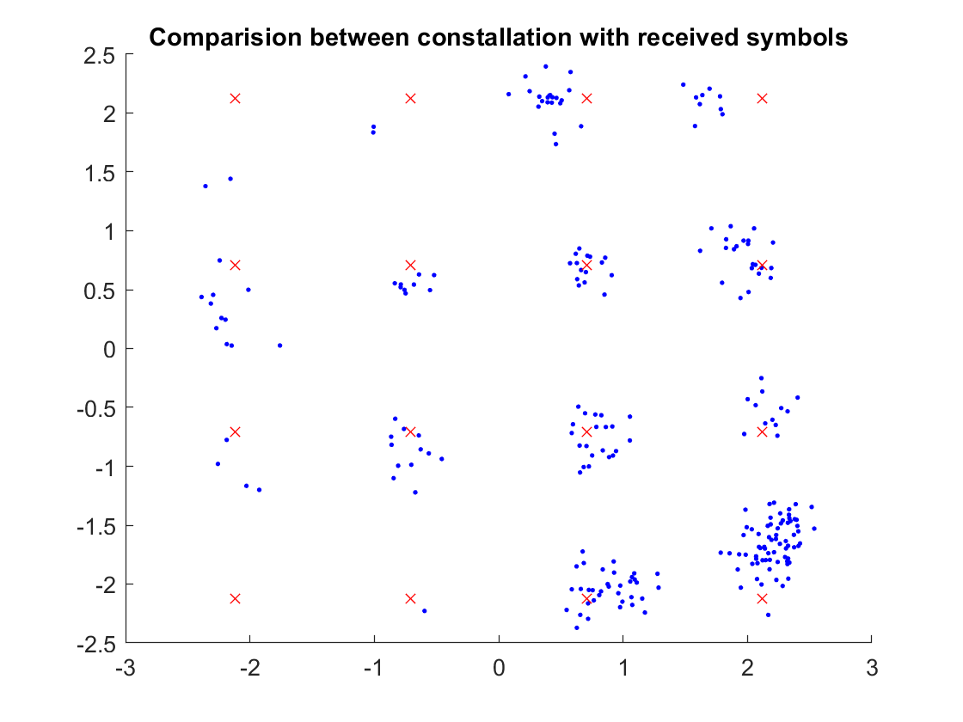
Results - Pushing the limit 16-QAM
Constellation: 16 - QAM
Frame symbols: 646
Symbol rate: 40 K
Bit errors: 18
Distance : 100 m

Slide 21
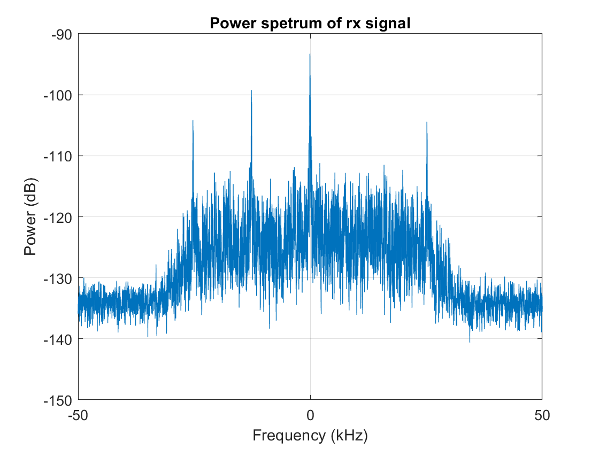
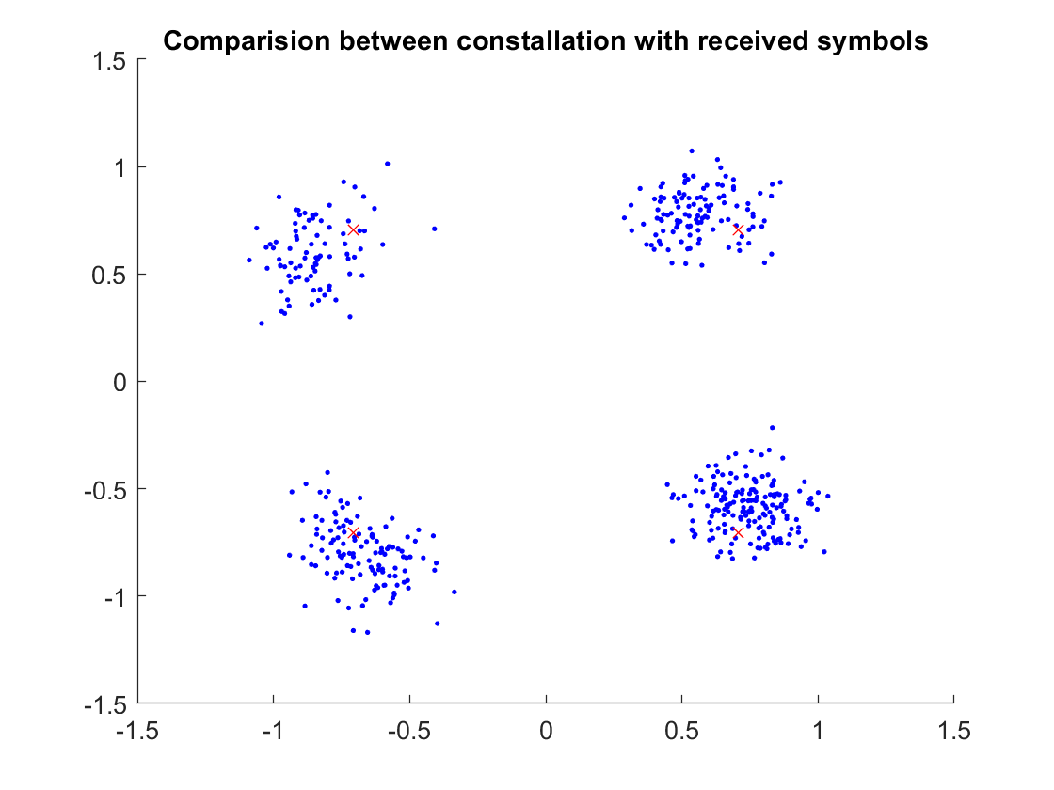
Results - Pushing the limit QPSK
Constellation: QPSK
Frame symbols: 892
Symbol rate: 50 K
Bit errors: 0
Distance : 100 m

Slide 22
Conclusion & Possible improvements
16-QAM
0 bit errors at a symbol rate of 12,5 k with 548 symbols
18 bit errors at a symbol rate of 40 k with 646 symbols
QPSK
0 bit errors at a symbol rate of 50 k with 492 symbols
Possible improvements
Time synchronization could be implemented.
Phase synchronization after the message as well (Using guard time).
SNR needs to be higher
More complex frequency sync
More copper pads for the capacitors
Different biasing technique
Debug ports for troubleshooting

Slide 23
Thank you for listening
Any questions?

